Slide 1
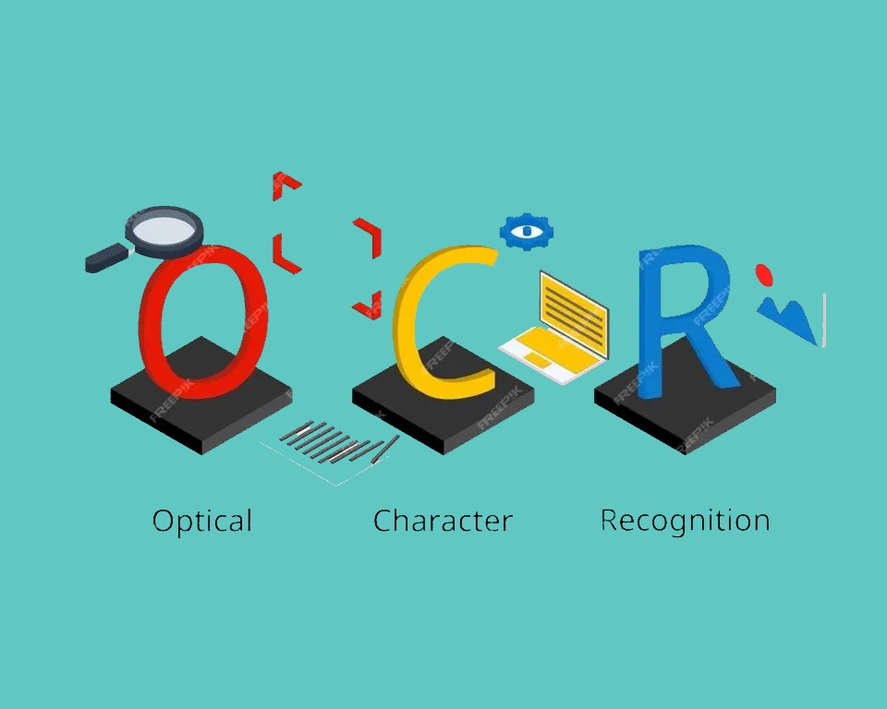
Bangla OCR for Hand-witten Texts
Group -5
Abdullah Rahat - 20301134
Jarin Akter Mou - 20301070
Hasim Reza - 21301343
Zaki Habib - 19201073

Slide 2
Introduction
OCR or Optical Character Recognition is a method that extracts text from images, documents etc.
Our project is to work with recognition model for Bangla handwritten text using Neural Network
Using OCR and Neural Network, it can be easy to translate handwritten images to digital text.

Slide 3
Why Neural Network for OCR
Pattern recognition and Adaptability of Neural Network
Improves performance of OCR by the help of end to end learning
Can Handle Complex Structures

Slide 4
Explored References of NN for OCR
Separable Multi-Dimensional Long Short-Term Memory Recurrent Neural Network(SMDLSTM-RNN) for Chinese Handwritten Text
Bangla Handwritten Character Recognition using Convolutional Neural Network with Data Augmentation
Template and feature matching for Bangla character recognition

Slide 5
Motivation
In the digital educational system, Bangla OCR for handwritten text can easily have a major impact.
Considering other languages, OCR for Bangla handwritten text is still in work
As new models releases with much more improvement time to time, the reognization system can also be improved using these new models.

Slide 6
Proposed Methodology
Seperable Multi-Dimensional Long Short-Term Memory Recurrent Neural Network
Bangla text recognition using SMDLSTM-RNN for improved results

Slide 7
Dataset
The single-page handwritings of 260 individuals of varied ages and personalities are included in the BanglaWriting dataset.
This dataset has 32,787 characters and 21,234 words in total. Moreover, 5,470 distinct Bangla vocabulary items are included in this collection.

Slide 8
Conclusion
Bangla OCR is a much needed in modernizing Bangladesh
Faster conversion speed using Neural Network applied in OCR
More accurate results using our chosen methodology

Slide 9
References
Y. -C. Wu, F. Yin, Z. Chen and C. -L. Liu, "Handwritten Chinese Text Recognition Using Separable Multi-Dimensional Recurrent Neural Network," 2017 14th IAPR International Conference on Document Analysis and Recognition (ICDAR), Kyoto, Japan, 2017, pp. 79-84, doi: 10.1109/ICDAR.2017.22.
R. R. Chowdhury, M. S. Hossain, R. ul Islam, K. Andersson and S. Hossain, "Bangla Handwritten Character Recognition using Convolutional Neural Network with Data Augmentation," 2019 Joint 8th International Conference on Informatics, Electronics & Vision (ICIEV) and 2019 3rd International Conference on Imaging, Vision & Pattern Recognition (icIVPR), Spokane, WA, USA, 2019, pp. 318-323, doi: 10.1109/ICIEV.2019.8858545
U. Pal and B. B. Chaudhuri, "OCR in Bangla: an Indo-Bangladeshi language," Proceedings of the 12th IAPR International Conference on Pattern Recognition, Vol. 3 - Conference C: Signal Processing (Cat. No.94CH3440-5), Jerusalem, Israel, 1994, pp. 269-273 vol.2, doi: 10.1109/ICPR.1994.576917.

